Slide 1
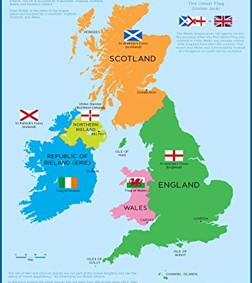
ELIT214
BRITISH CULTURAL HISTORY
Week-1

Slide 2
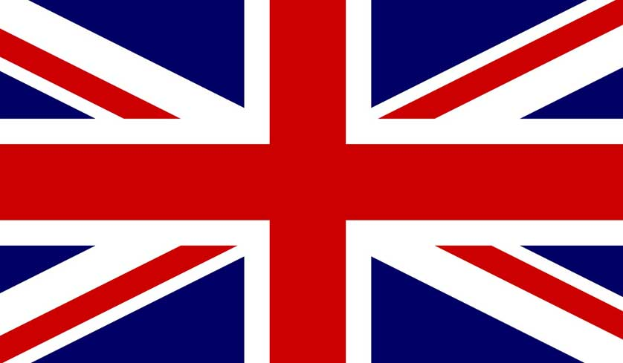
The Union Jack

Slide 3
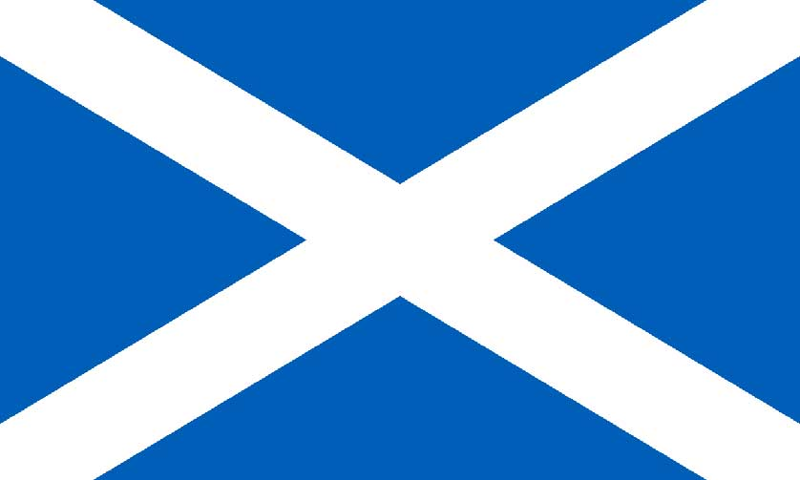
Scotland
Saltire
St. Andrew’s Cross

Slide 4
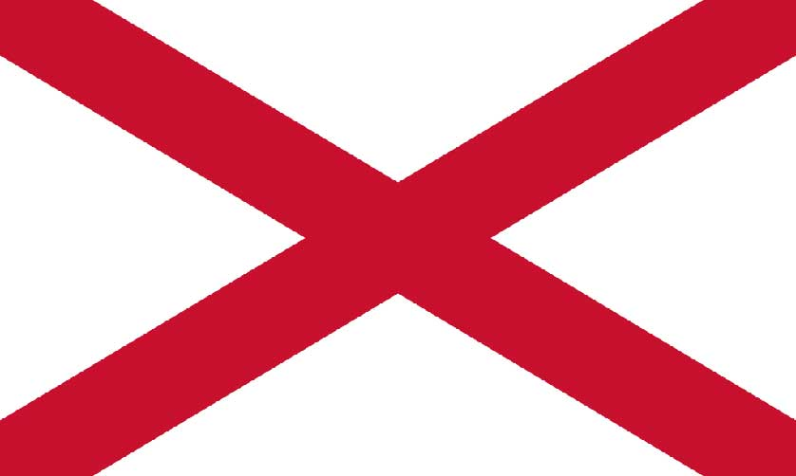
Northern Ireland
Cross of St. Patrick

Slide 5
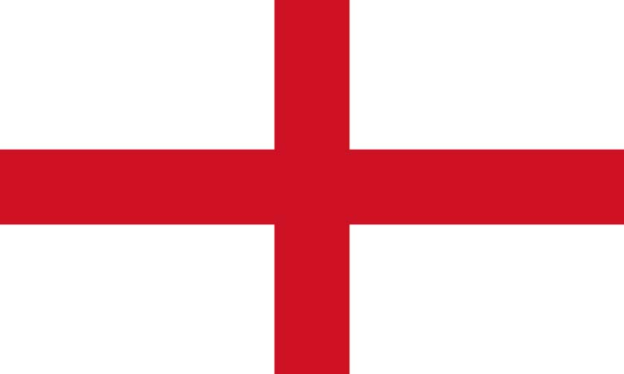
England
Cross of St.George

Slide 6
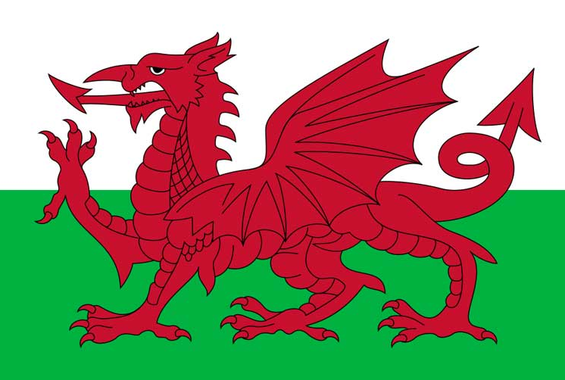
Wales
(Welsh Dragon)

Slide 7
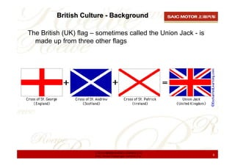

Slide 8
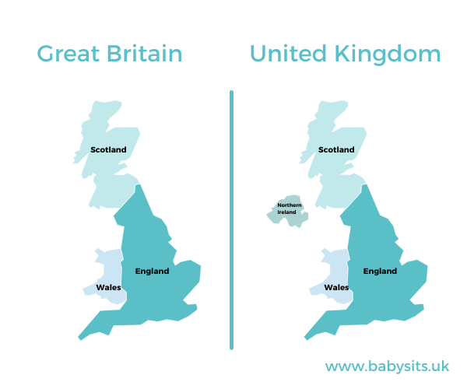

Slide 9
United Kingdom | Great Britain | England
The United Kingdom is a polity that encompasses the entire region of the British Isles with the exception of the Republic of Ireland | The term ‘Great Britain’ is often used to include England, Scotland Wales and its adjoining islands | England is one of the countries that is located in the southernmost part of the British Isle
The term “United Kingdom” has occasionally been used as a description for the former kingdom of Great Britain from the 17th century onwards | The term ‘Britain’ is derived from the Roman word ‘Britannia’. The word was extensively used by writers of classical antiquity to describe the British Isles following its conquest by the Roman Empire in 87 AD | England is derived from the Old English name ‘ Englaland’ which means land of the Angles. The Angles were a Germanic tribe who settled in large numbers following the withdrawal of Roman forces in 410 AD
The United Kingdom as a whole is the member of the Commonwealth of Nations, NATO and the United Nations amongst many other international bodies | The term ‘Great’ was added into Britain during the rule of King James I in 1603 as a way to assert his rule over both the Kingdom of Wales and Scotland | England is the largest country in the British Isles in terms of population and landmass. Its capital London is also the capital of the United Kingdom as a whole
Before the independence of Ireland on 29 December 1937, the term ‘United Kingdom of Great Britain and Northern Ireland was used. Upon its independence, the new term is ‘United Kingdom of Great Britain and Northern Ireland | Politically, Great Britain and Northern Island together constitute the United Kingdom | Just like Wales and Scotland, England is referred to as a country but is not a sovereign state. Although all the countries of the British Isles have their own parliament, certain matters are still referred to the Parliament of the United Kingdom

Slide 10
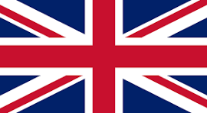
National Anthem of UK
God save our gracious King!
Long live our noble King!
God save the King!
Send him victorious,
Happy and glorious,
Long to reign over us:
God save the King!
Thy choicest gifts in store,
On him be pleased to pour;
Long may he reign:
May he defend our laws,
And ever give us cause,
To sing with heart and voice,
God save the King!^{[1]}
British National Anthem - "God Save The Queen" (EN)
YouTube · BlueMarbleNations3 minutes, 3 seconds
Sep 12, 2011
🇬🇧God Save the King 🇬🇧- The British National Anthem 2023 ...
YouTube · St Laurence's Church Chorley1 minute, 16 seconds
Sep 13, 2022

Slide 11
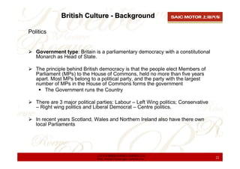

Slide 12
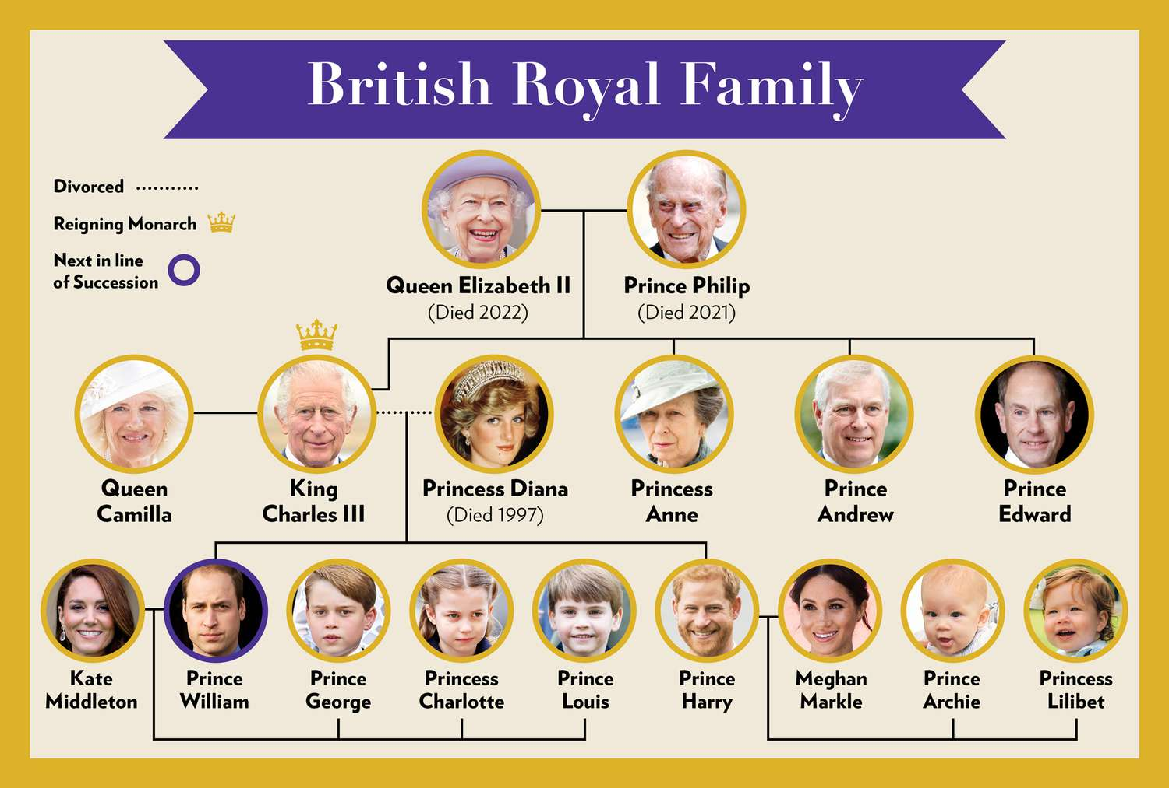

Slide 13
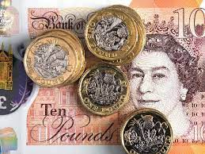
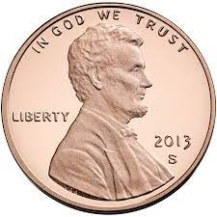
Currency of UK
1 Pound= 38.87 Turkish lira

Slide 14
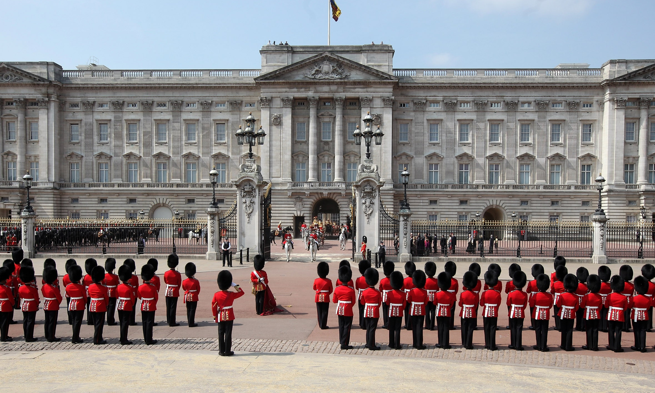
MONARCH resides in Buckingham Palace

Slide 15
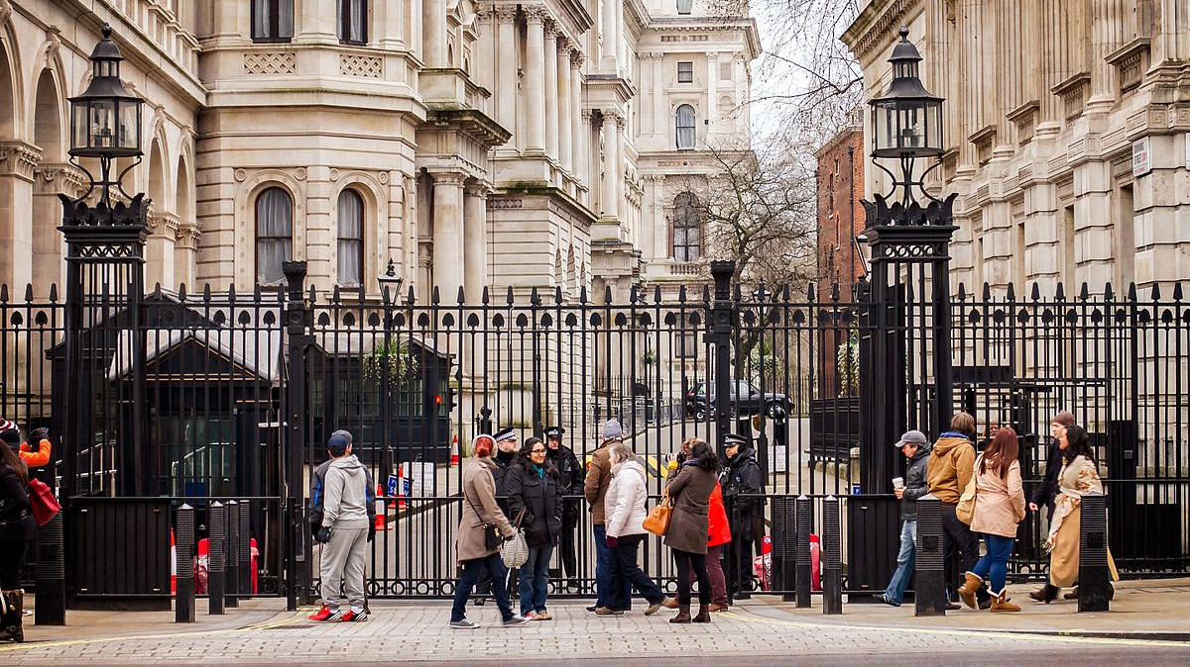
Prime minister resides in

Slide 16
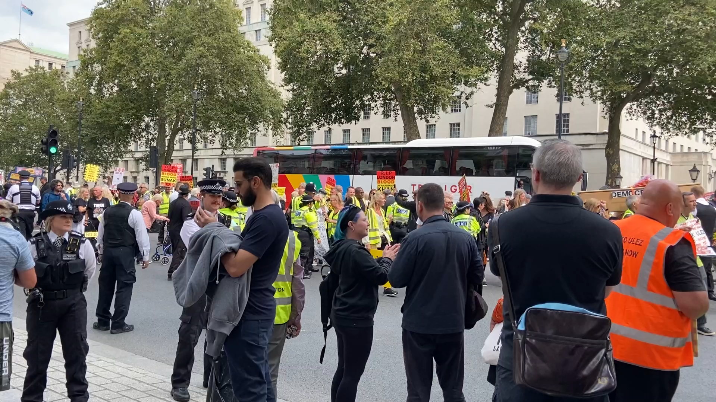

Slide 17
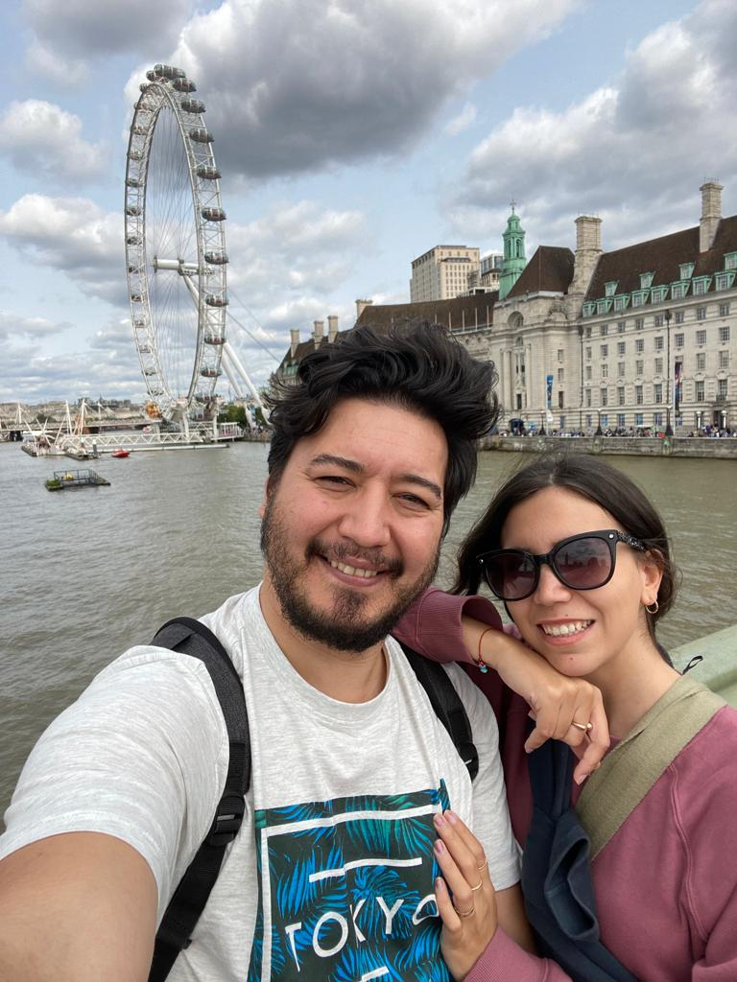
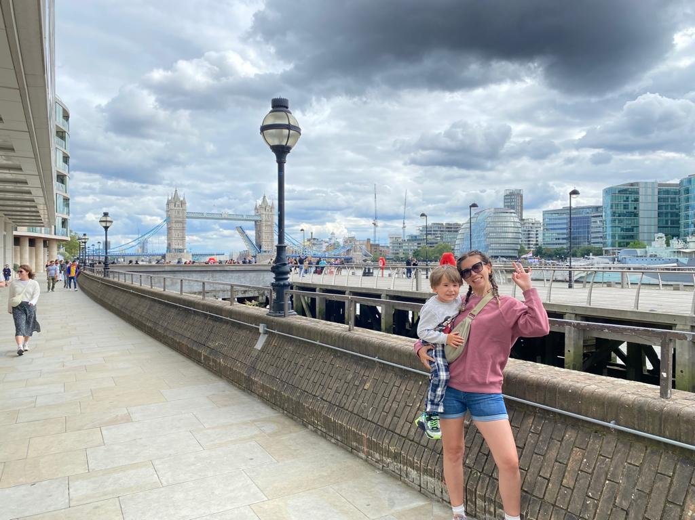
Famous river (The River Thames)

Slide 18
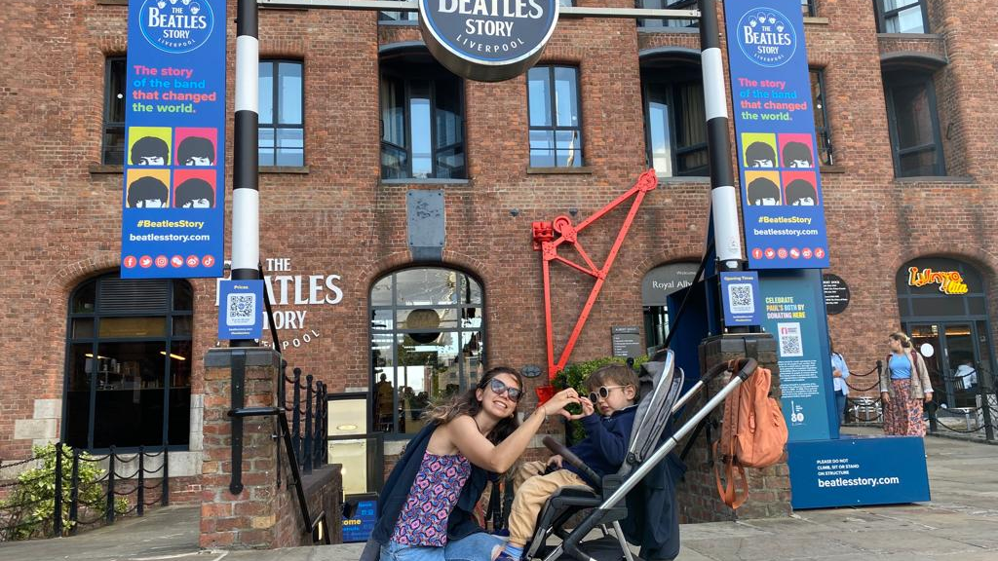
Beetles from Liverpool

Slide 19
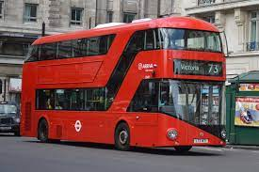
Double-decker

Slide 20
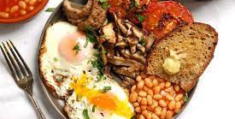
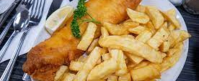
Most popular foods
FISH AND CHIPS
BREAKFAST

Slide 21

AFTERNOON TEA/ HIGH TEA

Slide 22


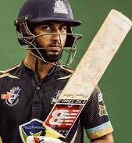
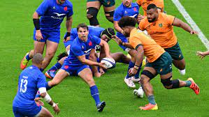
SPORTS
RUGBY, CRICKET, FOOTBALL, TENNIS, POLO, GOLF

